Slide 1
Ray Tracing Basics
CS 460: COMPUTER GRAPHICS

Slide 2
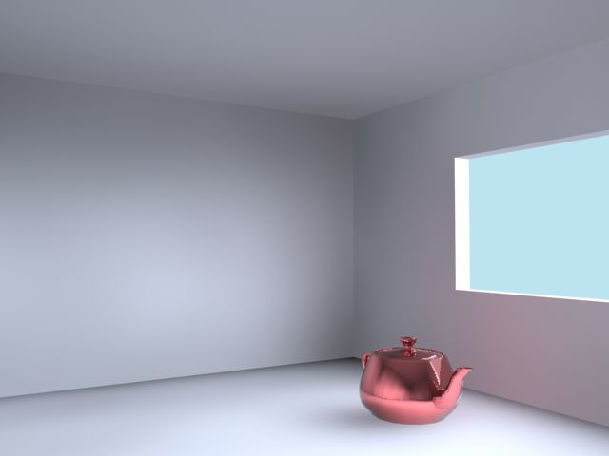

Slide 3
Ray Tracing
A “physical” simulation of the particle theory of light
In the 1960s, ray tracing seemed like a great idea, but nobody could do it well enough to beat cheaper image synthesis methods.
These days, we can follow the simulation deeply enough to get great results!
Slower than rasterization; Usually offline
Used in animated movies (e.g., Pixar)

Slide 4
Geometric optics
View of light based on geometric optics.
Here are the rules of geometric optics:
  Light is a flow of photons. We’ll call these flows “light rays.”
  Light rays travel in straight lines in free space.
  Light rays do not interfere with each other as they cross.
  Light rays obey the laws of reflection and refraction.
  Light rays travel from the light sources to the eye, but the physics is invariant under path reversal (reciprocity)

Slide 5
Why Ray Tracing?
So far, we can do ray casting:
  for each pixel in the projection plane, find the object visible at that pixel and
  color that pixel according to the object color
What does this model miss? What if the object is reflective?
Light Source
Eye Ray
Object
Object
Light Source

Slide 6
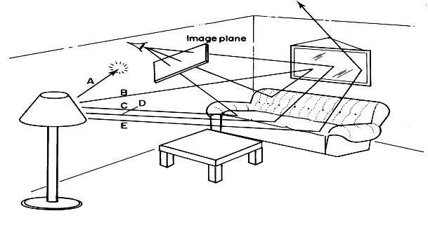
Forward Ray Tracing
Rays emanate from light sources and bounce around in the scene.
Rays that pass through the projection plane and enter the eye contribute to the final image.
What’s wrong with this method?

Slide 7
Backward Ray Tracing
Efficiency!
Rather than propagating rays indiscriminately from light sources, we’d like to ask “which rays will definitely contribute to the final image?”
We can get a good approximation of the answer by firing rays from the eye, through the projection plane and into the scene
  These are the paths that light must have followed to affect the image

Slide 8
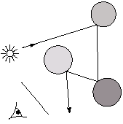
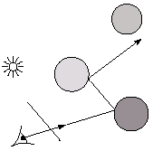
Eye vs. light ray tracing
Where does light begin?
At the light: light ray tracing (a.k.a. forward ray tracing or photon tracing)
At the eye: ray tracing (a.k.a. backward ray tracing)

Slide 9
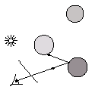
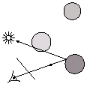
Precursors to ray tracing
Local illumination (e.g. OGL)
Cast one eye ray, then shade according to light (surface always got shaded regardless of occluders)
Appel (1968)
Cast one eye ray + one ray to light (look for shadow…)
occluder

Slide 10
Whitted ray-tracing algorithm
In 1980, Turner Whitted introduced ray tracing to the graphics community.
  Combines backward ray tracing + shadow ray
  Recursively traces rays
Algorithm:
1. For each pixel, trace an eye (primary)
ray in direction V to the first visible
surface (or ray casting).
2. For each intersection, trace secondary rays.
    Shadow rays in directions L_{i} to light sources (for each light).
    Reflected ray in direction R.
    Refracted ray or transmitted ray in direction T.

Slide 11
Kinds of (Backward) Rays
Three kinds of rays from the intersection point
  Shadow rays (for each light source)
  Reflected ray
  Refracted/transparency ray
Light Source
Reflected ray
Shadow Ray
Eye
Eye Ray
through
pixel center
Refracted
ray
Shadow Ray
Transparent
Object
Light Source

Slide 12
Kinds of (Backward) Rays
A ray traveling from the eye to the scene is called a primary ray.
When a ray hits an object, we spawn three new (backward) rays to collect light rays that contribute to the incoming primary ray:
  Shadow ray(s) to light source(s): 1) to attenuate incoming light when applying the shading model, 2) check if anything occluding the light source
  Reflected ray, which traces light bouncing off from other surfaces before hitting this surface
  Transmitted / Refracted ray, which traces light refracted through the surface before leaving along the primary ray (ignore this if the surface is not transparent)
Shadow rays stop at light sources, but both the reflected and refracted rays behave just like primary rays! Continue the tracing recursively!

Slide 13
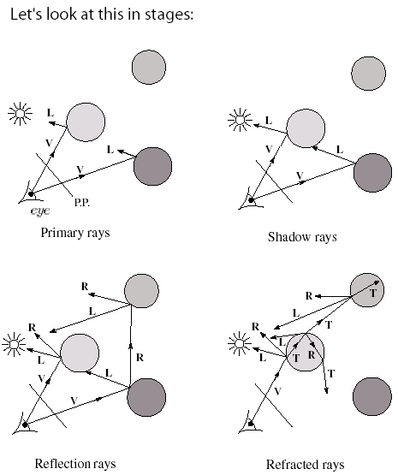
Whitted algorithm
V
L
R
T

Slide 14
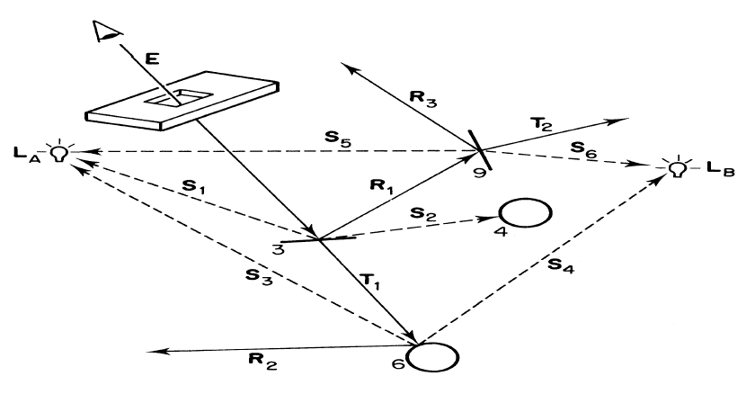
Example of Ray Tracing
start
here
light2
light1
Keys:
S – shadow rays
R – reflected rays
T – transparency rays

Slide 15
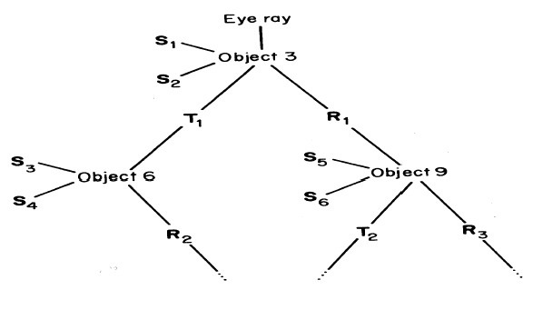
Ray Tree
A primary ray hits a surface and spawns reflected and transparency rays. Those rays may hit surfaces and spawn their own rays, etc.
We can represent this process
schematically using
a Ray Tree:
Assume Object 6 is opaque,
no need to trace refraction ray again then

Slide 16
Controlling Tree Depth
Ideally, we’d spawn child rays at every object intersection forever, getting a “perfect” color for the primary ray.
In practice, we need heuristics for bounding the depth of the tree (i.e., recursion depth)

Slide 17
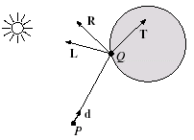
Shading
A ray is defined by an origin p and
a direction d (unit vector) and is
parameterized by t :
p + t d where t ≥ 0
Let I(P,d) be the intensity seen along that ray. Then:
I(P,d) = ∑ I_{direct} + I_{reflected} + I_{transmitted}
where
  I_{direct} is computed from the Phong model (zero is light occluded)
  I_{reflected} = k_{r} I ( Q , R ) (light coming from R)
  I_{transmitted} = k_{t} I ( Q , T ) (light coming from T)
light_{i}

Slide 18
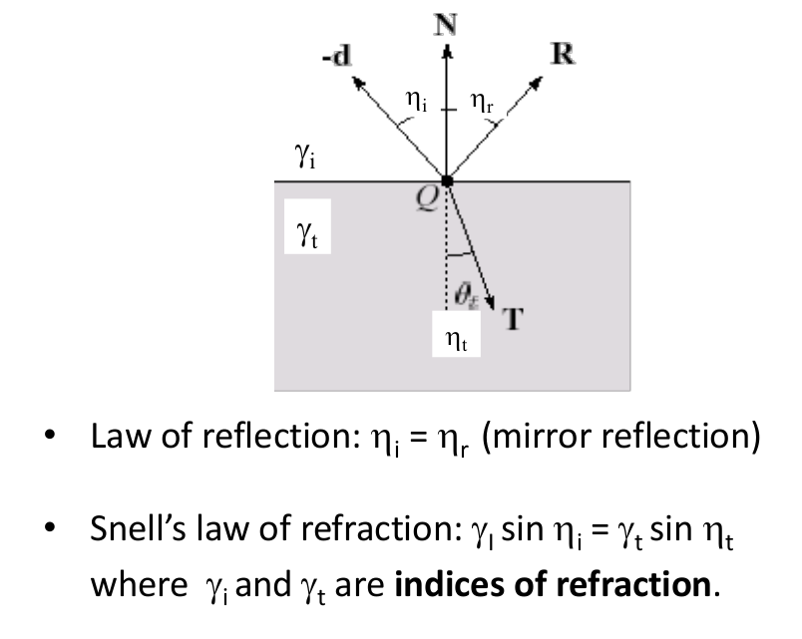
Reflection and Refraction

Slide 19
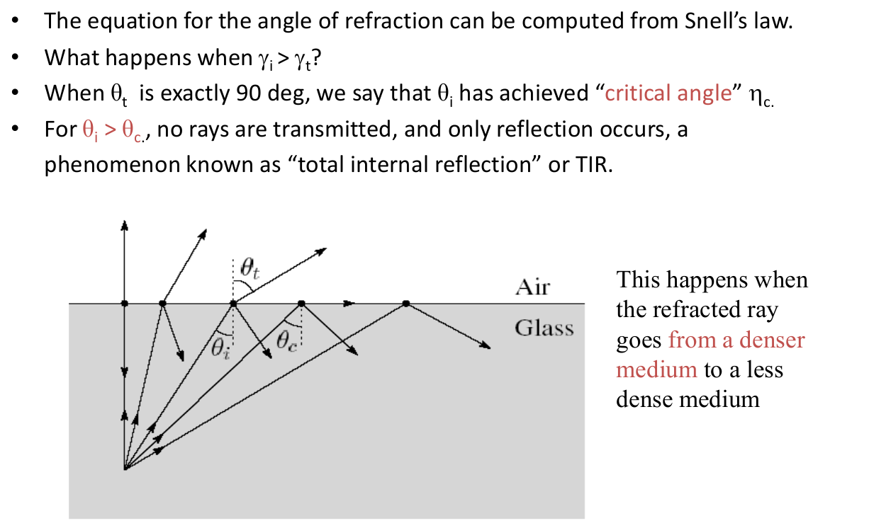
Total internal reflection
see this
e.g. from glass to air

Slide 20
A Recursive Ray Tracer
Now, put everything together…

Slide 21
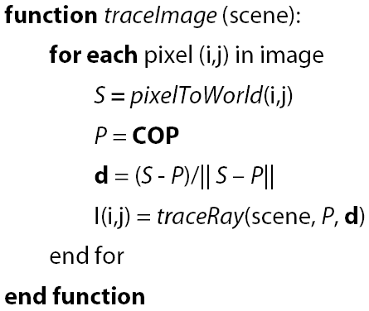
Ray tracing pseudocode
We build a ray traced image by casting rays through each of the pixels:
i.e. pixel location
in world space
i.e. camera location
in world space

Slide 22
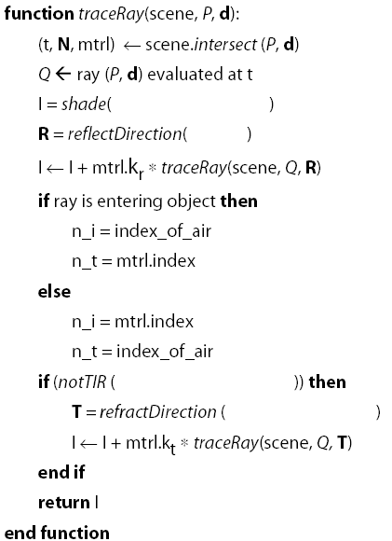
Ray tracing pseudocode (cont.)
Note: if no intersection, return background color (e.g., black)
Note:
mtrl is the material
at the intersection pt
N is the normal
Q is the intersection pt
I is from Phong model
R is reflected direction
T is refracted direction
TIR: total internal reflection

Slide 23
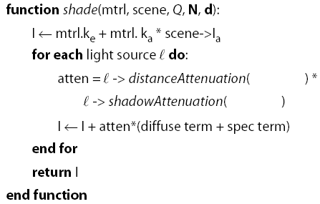
Shade
Next, we need to calculate the color returned by the shade function.

Slide 24
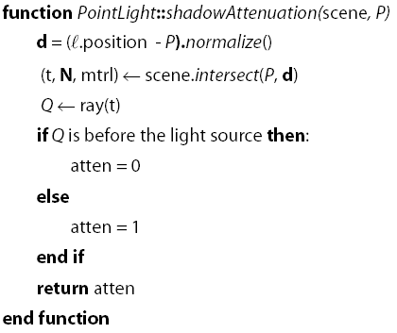
Shadow attenuation
Computing a shadow can be as simple as checking to see if a ray makes it to the light source.
For a point light source:
Q: What if there are transparent objects along a path to the light source?

Slide 25
Epsilons!!
Due to finite precision arithmetic, we do not always get the exact intersection at a surface.
Q: What kinds of problems might this cause?
Q: How might we resolve this?

Slide 26
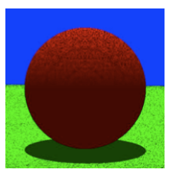
Epsilons!!
• In ray tracing, the origin of (secondary) rays is often on the surface
of objects
  – Theoretically, the intersection point should be on the surface
  – Practically, calculation imprecision creeps in, and the origin of the new ray maybe
  slightly beneath the surface
• Result: the surface area is shadowing itself

Slide 27
Epsilons!!
• Check if t is within some epsilon tolerance:
if abs(µ) < ε
point is on the surface
else
point is inside/outside
• Choose the ε tolerance empirically
  - Move the intersection point by epsilon along the surface
  normal so it is outside of the object
  - Check if point is inside/outside surface by checking the
  sign of the implicit (sphere etc.) equation

Slide 28
Intersecting with xformed geometry
In general, objects will be placed using transformations. What if object being intersected were transformed by a matrix M?
Apply M⁻¹ to the ray first (transform the ray to the object space) and intersect in object (local) coordinates!

Slide 29
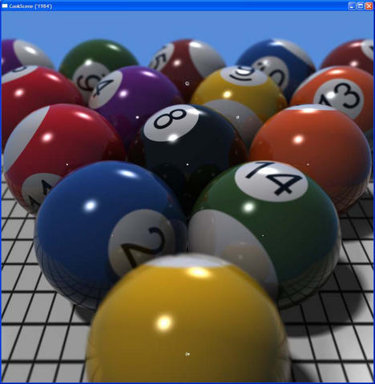

Slide 30
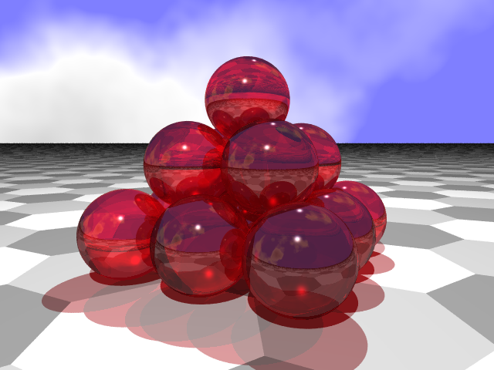

Slide 31
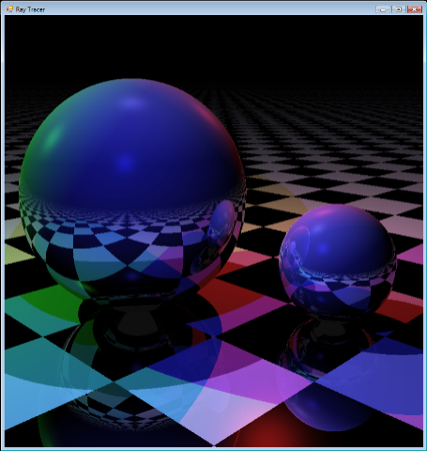

Slide 32
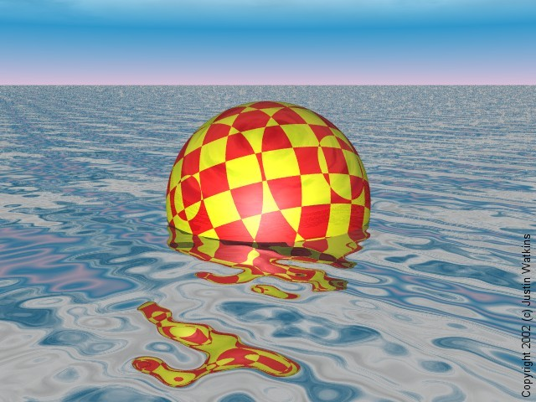

Slide 33


Slide 34
More examples
http://www.openrt.de/gallery.php
Notes:
http://www.youtube.com/watch?v=Cbnv_z6VDj8
http://www.youtube.com/watch?v=xiw4zQu2LIU
http://www.youtube.com/watch?v=eG7UGzNAMXQ

Slide 35
Summary
Understanding of basic ray tracing concepts
Forward vs. Backward Ray Tracing
Classification of rays
The Ray Tree
Terminating Recursion

